Slide 1
Lecture -12
Discrete Fourier Transform

Slide 2
Objective
To discuss about discrete Fourier transform
To solve problem using discrete Fourier transform

Slide 3
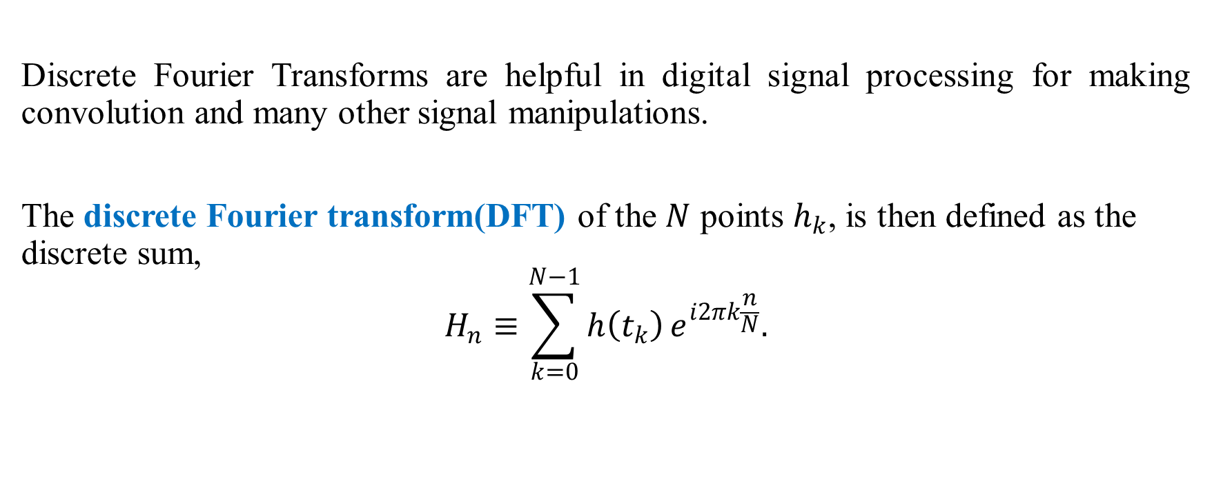
Discrete Fourier Transform
Discrete Fourier Transforms are helpful in digital signal processing for making convolution and many other signal manipulations.
The discrete Fourier transform(DFT) of the $N$ points $h_{k}$, is then defined as the discrete sum,
$$H_{n}≡\sum_{k=0}^{N−1}{h\left(t_{k}\right)}e^{i2πk\frac{n}{N}}.$$

Slide 4
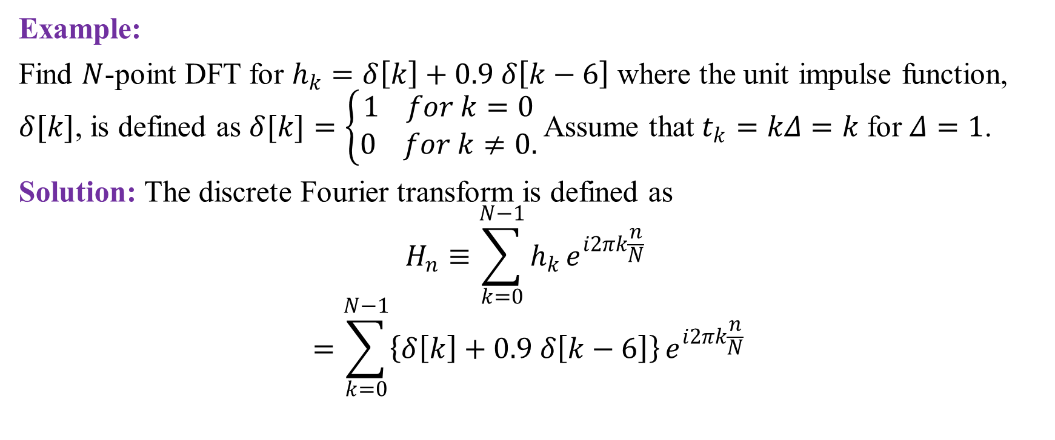
Example of Discrete Fourier Transform
Example:
Find $N$-point DFT for $h_{k}=δ\left[k\right]+0.9 δ\left[k−6\right]$ where the unit impulse function, $δ[k]$, is defined as $δ[k]=\left\{\begin{aligned}1 for k=0 \\ 0 for k≠0.\end{aligned}\right.$ Assume that $t_{k}=kΔ=k$ for $Δ=1$.
Solution: The discrete Fourier transform is defined as
$$H_{n}≡\sum_{k=0}^{N−1}{h_{k}}e^{i2πk\frac{n}{N}}$$
$$=\sum_{k=0}^{N−1}{\left\{δ\left[k\right]+0.9 δ\left[k−6\right]\right\}}e^{i2πk\frac{n}{N}}$$

Slide 5

Example of Discrete Fourier Transform (continued)
$$=δ\left[0\right]e^{0}+0.9 δ\left[6−6\right]e^{i2π6\frac{n}{N}}$$
$$=1+0.9e^{i12π\frac{n}{N}}$$
$$=1+0.9\left[\cos\left(12π\frac{n}{N}\right)+i \sin\left(12π\frac{n}{N}\right)\right] \left[∵e^{iθ}=\cos{θ}+i\sin{θ}\right]$$
where $n=0, 1, 2, …, N−1.$ (Ans)

Slide 6

Sample Exercise
Find $N$-point DFT for the following signal $h_{k}$:
$h_{k}=1.7 δ[k]$
$h_{k}=5.5 δ[k−3]$
$h_{k}=3 δ\left[k\right]+8 δ\left[k−1\right]$
$h_{k}=0.5 δ \left[k−2\right]−2 δ\left[k−4\right]$

Slide 7

Sample MCQ
What is the value of $δ\left[k\right] at k=0$
1 b) 0 c) 3 d) 4
What is the value of $δ\left[k−4\right] at k=4$
a) 1 b) 0 c) both d) none

